Slide 1

DEPARTMENT OF PHYSICS AND NANOTECHNOLOGY
SRM INSTITUTE OF SCIENCE AND TECHNOLOGY
18PY103J – Physics: Semiconductor Physics
Module-V, Lecture-13
Scanning Electron Microscope (SEM)
18PYB101J Module-V Lecture-13

Slide 2
Scanning Electron Microscope (SEM)
Working Concept
SEM allows surfaces of objects to be seen in their natural state without staining.
The specimen is put into the vacuum chamber and covered with a thin coating of gold to increase electrical conductivity and thus forms a less blurred image.
The electron beam then sweeps across the object building an image line by line as in a TV Camera.
As electrons strike the object, they knock loose showers of electrons that are captured by a detector to form the image.
18PYB101J Module-V Lecture-13

Slide 3
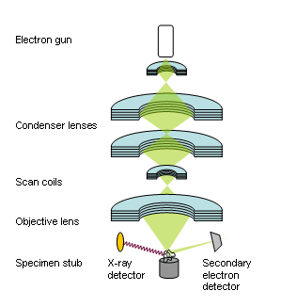
Working concept of SEM
18PYB101J Module-V Lecture-13

Slide 4
The "Virtual Source" at the top represents the electron gun, producing a stream of monochromatic electrons.
The stream is condensed by the first condenser lens (usually controlled by the "coarse probe current knob").
This lens is used to both form the beam and limit the amount of current in the beam.
It works in conjunction with the condenser aperture to eliminate the high-angle electrons from the beam
The beam is then constricted by the condenser aperture, eliminating some high-angle electrons
The second condenser lens forms the electrons into a thin, tight, coherent beam and is usually controlled by the "fine probe current knob"
18PYB101J Module-V Lecture-13

Slide 5
A set of coils then "scan" or "sweep" the beam in a grid fashion (like a television), dwelling on points for a period of time determined by the scan speed (usually in the microsecond range)
The final lens, the Objective, focuses the scanning beam onto the part of the specimen desired.
When the beam strikes the sample (and dwells for a few microseconds) interactions occur inside the sample and are detected with various instruments
Before the beam moves to its next dwell point these instruments count the number of interactions and display a pixel on a CRT whose intensity is determined by this number (the more reactions the brighter the pixel).
This process is repeated until the grid scan is finished and then repeated, the entire pattern can be scanned 30 times per second.
18PYB101J Module-V Lecture-13

Slide 6
Specimen Interactions and utilization:
Backscattered Electrons
Formation
Caused by an incident electron colliding with an atom in the specimen which is nearly normal to the incident's path.
The incident electron is then scattered "backward" 180 degrees.
Utilization
The production of backscattered electrons varies directly with the specimen's atomic number.
This differing production rates causes higher atomic number elements to appear brighter than lower atomic number elements.
This interaction is utilized to differentiate parts of the specimen that have different average atomic number.
18PYB101J Module-V Lecture-13

Slide 7
Secondary Electrons
Source
Caused by an incident electron passing "near" an atom in the specimen, near enough to impart some of its energy to a lower energy electron (usually in the K-shell).
This causes a slight energy loss and path change in the incident electron and the ionization of the electron in the specimen atom.
This ionized electron then leaves the atom with a very small kinetic energy (5eV) and is then termed a "secondary electron".
Each incident electron can produce several secondary electrons.
18PYB101J Module-V Lecture-13

Slide 8
Utilization
Production of secondary electrons is very topography related.
Due to their low energy, 5eV, only secondaries that are very near the surface (<10nm,) can exit the sample and be examined.
Any changes in topography in the sample that are larger than this sampling depth will change the yield of secondaries due to collection efficiencies.
Collection of these electrons is aided by using a "collector" in conjunction with the secondary electron detector.
The collector is a grid or mesh with a +100V potential applied to it which is placed in front of the detector, attracting the negatively charged secondary electrons to it which then pass through the grid-holes and into the detector to be counted.
18PYB101J Module-V Lecture-13

Slide 9
Auger Electrons
Source
Caused by the de-energization of the specimen atom after a secondary electron is produced.
Since a lower (usually K-shell) electron was emitted from the atom during the secondary electron process an inner (lower energy) shell now has a vacancy.
A higher energy electron from the same atom can "fall" to a lower energy, filling the vacancy.
This creates and energy surplus in the atom which can be corrected by emitting an outer (lower energy) electron; an Auger Electron.
18PYB101J Module-V Lecture-13

Slide 10
Utilization
Auger Electrons have a characteristic energy, unique to each element from which it was emitted from.
These electrons are collected and sorted according to energy to give compositional information about the specimen
18PYB101J Module-V Lecture-13

Slide 11
X-rays
Source
Caused by the de-energization of the specimen atom after a secondary electron is produced.
Since a lower (usually K-shell) electron was emitted from the atom during the secondary electron process an inner (lower energy) shell now has a vacancy.
A higher energy electron can "fall" into the lower energy shell, filling the vacancy.
As the electron "falls" it emits energy, usually X-rays to balance the total energy of the atom so it .
X-rays or Light emitted from the atom will have a characteristic energy which is unique to the element from which it originated.
18PYB101J Module-V Lecture-13

Slide 12
Electron beam
Cathodoluminescence
Auger electrons
Bremsstrahlung
Secondary electrons
Characteristic x-rays
Backscattered electrons
Heat
Specimen current
Elastically
scattered electrons
Transmitted and inelastically
scattered electrons
18PYB101J Module-V Lecture-13

Slide 13
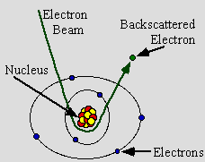
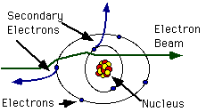
BSE
SE
18PYB101J Module-V Lecture-13

